Slide 1
The Essential
..Role of
Business Letters in Professional Communication

Slide 2


1. Introduction
Business letters play an indispensable role in professional communication. They serve as formal written documents that assist in conveying information, making inquiries, or expressing thoughts. These letters are a key tool for maintaining professional relationships and fostering business growth. By adherin g to standard formats and employing professional language, business letters ensure effective and efficient communication between individuals and organizations.

Slide 3

2. Definition of Business Letters
Business letters are written documents that facilitate effective and professional communication in a business setting. They serve as a formal means of conveying information, making inquiries, expressing thoughts, and maintaining professional relationships. By following standard formats and usin g appropriate language, business letters ensure clear and concise communication, enhancin g organizational efficiency and fostering business growth.

Slide 4

3. Importance of
Business Letters in
Professional Communication
Business letters play a crucial role in professional communication as they help establish a formal and professional tone. They provide a written record of important discussions and agreements, ensurin g clarity and avoiding misunderstandin gs. Additionally, business letters create a professional image for the company, enhance credibility, and build strong relationships with clients, suppliers, and stakeholders.

Slide 5

4. Types of Business Letters
There are four main types of business letters:
Inquiry letters, used to gather information or request clarification.
Complaint letters, to express dissatisfaction and seek resolution.
Persuasive letters, aimed at influencin g the reader's decision or action.
Thank you letters, to express gratitude and maintain positive relationships with clients, suppliers, and stakeholders. Each type serves a specific purpose in professional communication and should be crafted carefully to achieve desired outcomes.

Slide 6
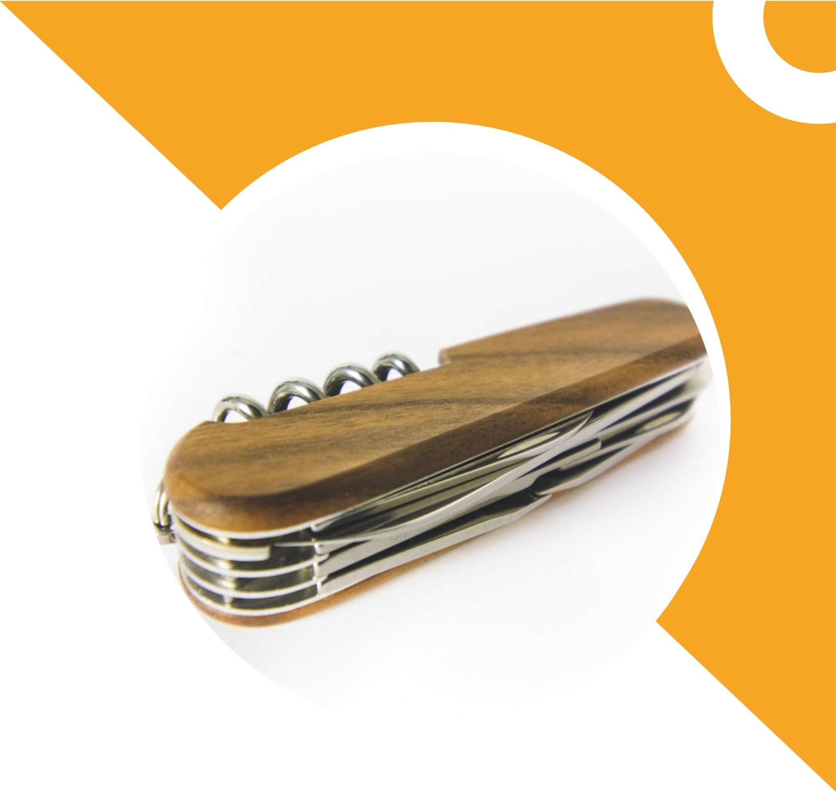
5.Elements of an Effective Business Letter
To create an effective business letter, there are five key elements to consider. Firstly, ensure your letter is concise and well-structured, with a clear introduction, body, and conclusion. Secondly, use a professional and respectful tone, addressing the recipient appropriately. Thirdly, provide relevant and specific details to support your message. Fourthly, use proper grammar, punctuation, and formatting for a polished appearance. Finally, proofread your letter for any errors before sending it, ensuring it reflects your professionalism and attention to detail.

Slide 7

6. Writing Style and Tone in Business Letters
In addition to the key elements of a business letter, the writing style and tone play a crucial role in professional communication. It is important to maintain a formal and professional tone throughout the letter, avoiding any casual or informal language. The style should be clear, concise, and respectful, demonstrating professionalism and establishing credibility with the recipient. Proper use of language and tone can greatly enhance the effectiveness of a business letter.

Slide 8

7. Formatting and Structure of Business Letters
The proper formatting and structure of a business letter are essential for effective communication. A well-structured letter includes a formal introduction, clear and concise body paragraphs, and a professional conclusion. Pay attention to spacing, font size, and margins to ensure the letter looks organized and professional. Proper formatting demonstrates attention to detail and professionalism, making a positive impression on the recipient.

Slide 9

8.Addressing Common Challenges in Business Letters
While business letters are a vital form of professional communication, they often come with challenges. Some common issues include usin g appropriate language and tone, striking a balance between formality and friendliness, and addressing recipients correctly. By being mindful of these challenges and employing effective strategies, you can ensure that your business letters are clear, respectful, and impactful.

Slide 10

9. Tips for Writing Effective Business Letters
Writing an effective business letter requires attention to detail. Start by clearly stating the purpose of your letter and usin g a professional tone. Keep your language concise, use appropriate greetings and salutations, and proofread for errors. Remember to personalize the letter and include all necessary information. Finally, end with a polite closing and your contact information for easy follow-up.

Slide 11

10. Conclusion
The Power of Effective Business Letters

